Slide 1
Introduction to the Module
SET10108 – Concurrent and Parallel Systems

Slide 2
What is Concurrency?
What do you think we mean by concurrency?
The standard definition of concurrency is a system that has multiple computations executing simultaneously which may also be interacting with each other
Do you think that this definition covers your understanding of concurrency?
There are also formal models to help us understand concurrency
If you did Fundamentals of Parallel Systems you have played around in one of those formal models – Communicating Sequential Processes

Slide 3
What is Parallelism?
What do you think we mean by parallelism?
Parallelism generally refers to the actual running of computations simultaneously and requires some form of hardware support to achieve
Multicore, GPU, etc
Do you think that this definition covers your understanding of parallelism? How does it differ to concurrency? Are they more or less the same?

Slide 4
Module Aims
Understand what we mean by concurrent and parallel systems
Build concurrent and parallel applications to solve particular problems
Analyse and measure concurrent and parallel applications to determine their performance

Slide 5
Learning Outcomes
LO1: Critically evaluate approaches to concurrent and parallel systems development
LO2: Compare and contrast the use of different parallel systems techniques to solve particular problem types
LO3: Design and construct parallel algorithms to solve particular problem types
LO4: Analyse the performance of parallel systems undertaking particular work types

Slide 6
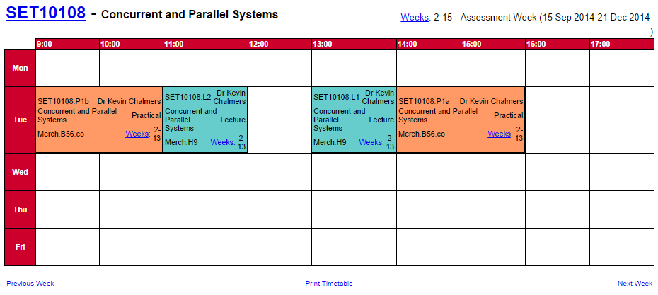
Timetable

Slide 7
Coursework
Coursework will make up 50% of the overall module mark
Two phases
Test and analyse a CPU based application and determine the best methods to improve performance, with appropriate measurements
Build an application to solve a particular problem and show the improvement in performance over a standard serial version
There will also be an overall class challenge for those who want to test their skills

Slide 8
Exam
Exam is worth the other 50% of the module
This will focus on the theory and technology covered in the module
We will also look at particular case studies which examine performance and technologies
Follow the directed reading – it might come up in the exam

Slide 9
Work Plan
This is not another crazy Kevin module where you build a large system
This is algorithm and technique based, and you need to understand concepts and use them in particular ways
The directed reading and exercises are far more important to aid your understanding – you need to fully realise how to approach parallel problem solving using different techniques
This is also an opportunity to study GPU programming
A very desirable skill at present

Slide 10
Multi-threading
The first part of the module will cover traditional multi-threading approaches using C++11
Threads
Mutexes
Conditions
You have likely covered some of this already, but maybe not in the manner we are approaching things
Performance
Problem solving

Slide 11
Instruction Level Parallelism
We will also look at how modern CPUs can perform parallel operations
Single Instruction Multiple Data (SIMD)
Vector processing
Very good for particular tasks, but very limited in what is possible
Requires low level manipulation of data and instructions – is therefore difficult to operate cross platform

Slide 12
Distributed Parallelism
We will also look at how we can exploit multi-machine parallelism across a network
We will use MPI (Message Passing Interface) to support our distributed parallelism
MPI is the industry standard approach
MPI is fast and efficient – for a distributed architecture
We will look at the problems of I/O and CPU bound problems here as well

Slide 13
GPU Programming
We will finish the module by doing some GPU programming via OpenCL and CUDA
OpenCL and CUDA work using small programs that process data on the GPU and return a result
Much like using shaders in many regards
We will be examining data parallel problems in more detail during this section of the module

Slide 14
Concepts

Slide 15
Why work in concurrency and parallelism?
Software developers relied on CPU performance increases to overcome limitations caused by larger computational problems
From 1986 till 2002 CPU speeds increased by an average of 50% per year
This is no longer the case
Since 2002 the average increase is 20% per year – and this has been due to multicore
We can no longer rely on faster single core performance to overcome our performance limitations

Slide 16
Moore’s Law
Moore’s Law states that CPU performance will double every 18 months
Do you think this is still the case?
This isn’t actually Moore’s Law. Moore’s Law states that transistors per square inch would double every 18 months
Do you think this is still the case?
In fact, current projections place Moore’s Law to have become obsolete at the end of 2013

Slide 17
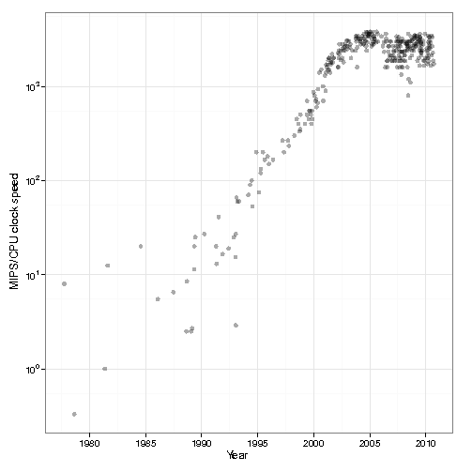
CPU Clock Speeds
CPU clock speeds levelled out around 2005
Who can remember buying 3.2GHz processors – we can’t really get much better now
Our big problem is the heat generated on the chip at the high clock speeds – we cannot cool the CPU fast enough
Multicore has been proposed as the solution to the problem

Slide 18
CPU Core Count
2005 – Intel 3.2 GHz Pentium 4 with dual core
This is also the year of the tri-core Xbox 360 and Cell based PS3
2007 – Intel Core 2 Quad Q6600
First quad core on the market
2013 – Octa (8) Core processors becoming the norm?
Xbox One, PS4, mobile devices
We now go by core counts to try and boast about performance
GPUs easily win this by the way – they can have thousands of cores
Multicore also have their problems as we will examine in the module
Memory bandwidth will be the killer

Slide 19
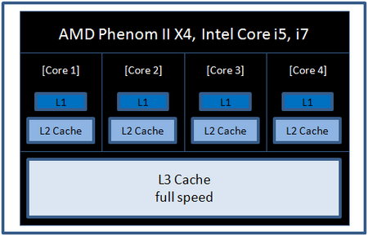
CPU Architecture

Slide 20
Memory Bandwidth
Our biggest problem today comes from memory bandwidth
More cores = more memory reads (usually discontinuous) = more time core spent waiting for memory read and write
Current architectures won’t support much beyond 16 cores before we bottle neck performance
GPU read/write is even worse
We will come to this later in the module

Slide 21
Distributed and GPU have limitations too…
The general rule of thumb you might believe is that GPUs and cluster computing will overcome our local performance limitations however…
GPUs have slow memory access for the CPU – really slow
GPUs only solve particular types of problems – data parallel
Distributed parallelism has to deal with latency and bandwidth issues
100 Mbit/s is very slow - have to make your problems CPU bound not I/O bound

Slide 22
Performance Considerations

Slide 23
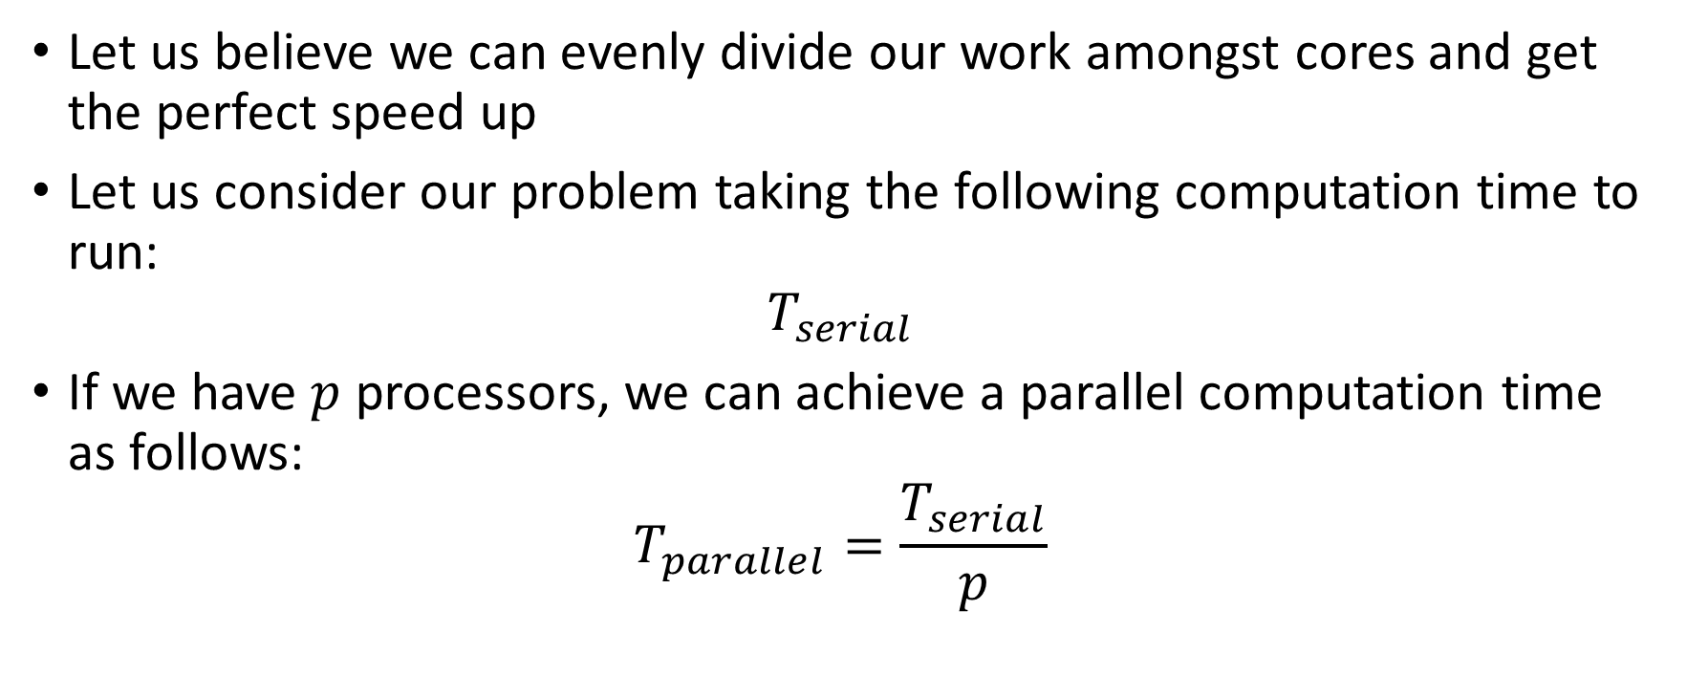
Performance
Let us believe we can evenly divide our work amongst cores and get the perfect speed up
Let us consider our problem taking the following computation time to run:
$$T_{serial}$$
If we have $p$ processors, we can achieve a parallel computation time as follows:
$$T_{parallel}=\frac{T_{serial}}{p}$$

Slide 24
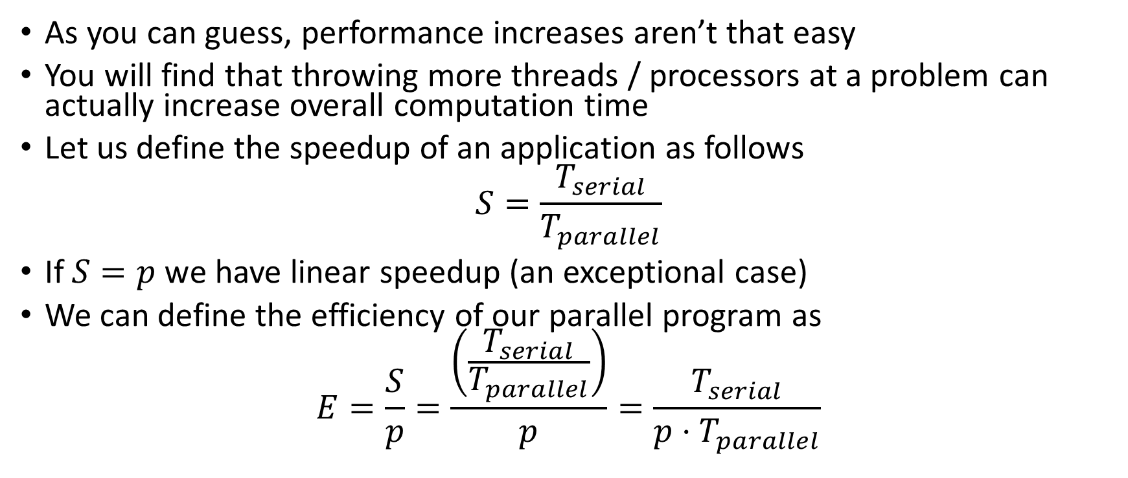
Performance
As you can guess, performance increases aren’t that easy
You will find that throwing more threads / processors at a problem can actually increase overall computation time
Let us define the speedup of an application as follows
$$S=\frac{T_{serial}}{T_{parallel}}$$
If $S=p$ we have linear speedup (an exceptional case)
We can define the efficiency of our parallel program as
$$E=\frac{S}{p}=\frac{\left(\frac{T_{serial}}{T_{parallel}}\right)}{p}=\frac{T_{serial}}{p⋅T_{parallel}}$$

Slide 25
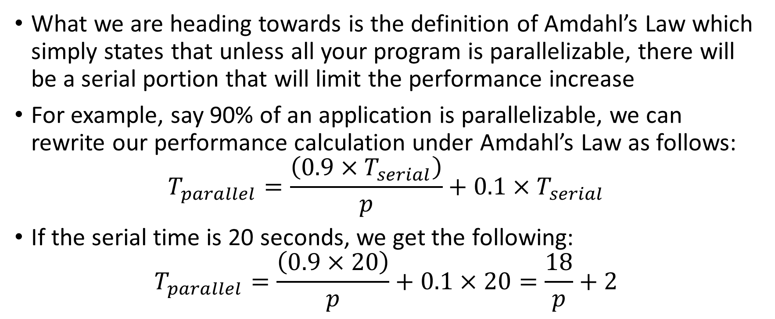
Amdahl’s Law
What we are heading towards is the definition of Amdahl’s Law which simply states that unless all your program is parallelizable, there will be a serial portion that will limit the performance increase
For example, say 90% of an application is parallelizable, we can rewrite our performance calculation under Amdahl’s Law as follows:
$$T_{parallel}=\frac{\left(0.9×T_{serial}\right)}{p}+0.1×T_{serial}$$
If the serial time is 20 seconds, we get the following:
$$T_{parallel}=\frac{\left(0.9×20\right)}{p}+0.1×20=\frac{18}{p}+2$$

Slide 26
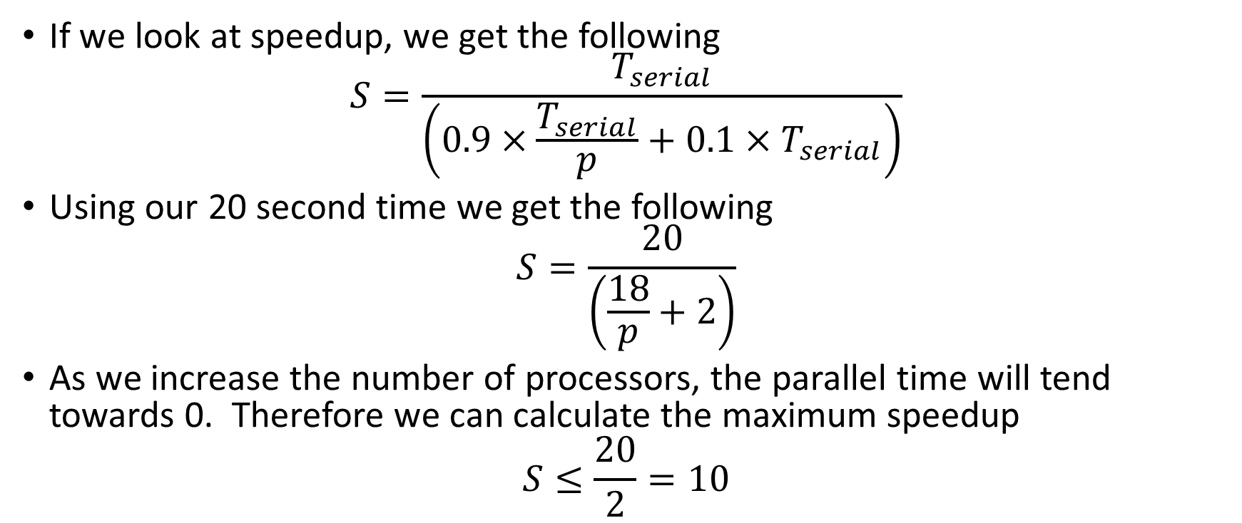
Amdahl’s Law
If we look at speedup, we get the following
$$S=\frac{T_{serial}}{\left(0.9×\frac{T_{serial}}{p}+0.1×T_{serial}\right)}$$
Using our 20 second time we get the following
$$S=\frac{20}{\left(\frac{18}{p}+2\right)}$$
As we increase the number of processors, the parallel time will tend towards 0. Therefore we can calculate the maximum speedup
$$S≤\frac{20}{2}=10$$

Slide 27
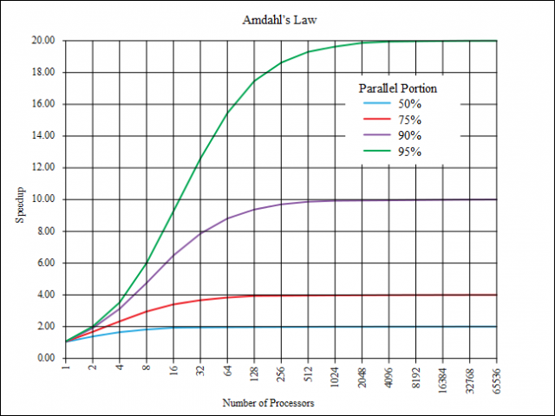

Slide 28
Resources

Slide 29
Software
We will be working in C++11
This means you will need a C++11 compiler
Visual Studio 2012 & 2013 supports C++11 – Visual Studio 2010 does not
GCC and Clang also support C++11
We will also be using some of the tools in Visual Studio Ultimate
The Games Lab has this if you are not working on Windows
We will also be using several libraries to support our work
OpenMP
MPI
OpenCL
CUDA
C++ AMP
I will cover the Microsoft tool chains for these, not others. I should be able to help though

Slide 30

Recommended Reading
An Introduction to Parallel Programming by Pacheco
Main course text
Covers most of the topics we will look at in the module
We will do multithreading differently using C++11
Does not cover GPU

Slide 31
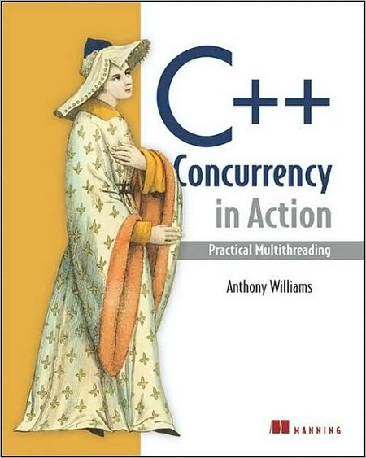
Recommended Reading
C++ Concurrency in Action by Williams
Covers the new C++11 concurrency standard
We will use this when looking at multithreading

Slide 32

Recommended Reading
Heterogeneous Computing with OpenCL by Gaster et. al.
Covers the GPU programming part of the module
Numerous other OpenCL resources out there – worth investigating if you are interested

Slide 33
This week…
A workbook is available for the module
On Moodle
Currently polishing off the last couple of units
Practical 1 focuses on basic multithreading in C++11 and how to capture results
This is very important – the module is about analysis and data gathering. You need to get into the habit of testing and data gathering from the start
Work through chapters 1 and 2 of C++ Concurrency in Action

